Slide 1

Data Visualization
Soon Chye Lim

Slide 2
Why Use Price Per Square Foot As A Measure?
Different Housing has different size/square foot
It is not fair if we just compare pricing without taking the size into consideration
For example, and hypothetically speaking…
You have $100,000 House with 100,000 sq ft Versus You have $10 House with 1 sq ft
Which one is more worth it? In terms of PSF, first one is 1PSF and the second one is 10PSF
Monetary speaking, $100,000 House is more worth it.

Slide 3
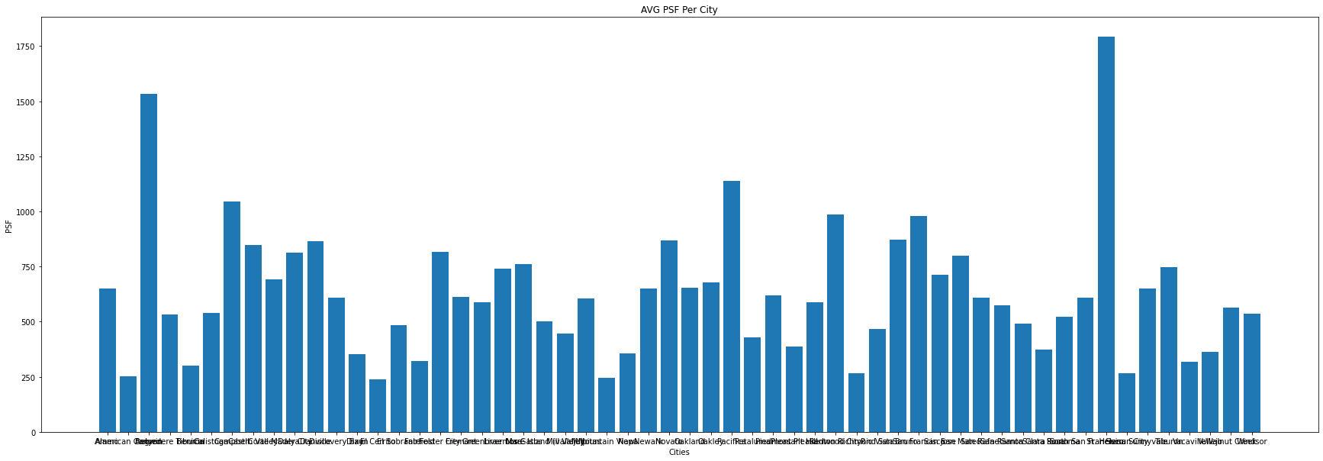
Avg Per Square Foot Grouped by City

Slide 4
Findings:
Most Expensive PSF (Top 3):
St. Helena, Angwin, Pacifica
Least Expensive PSF (Bottom 3):
El Cerrito, Mountain View, American Canyon

Slide 5
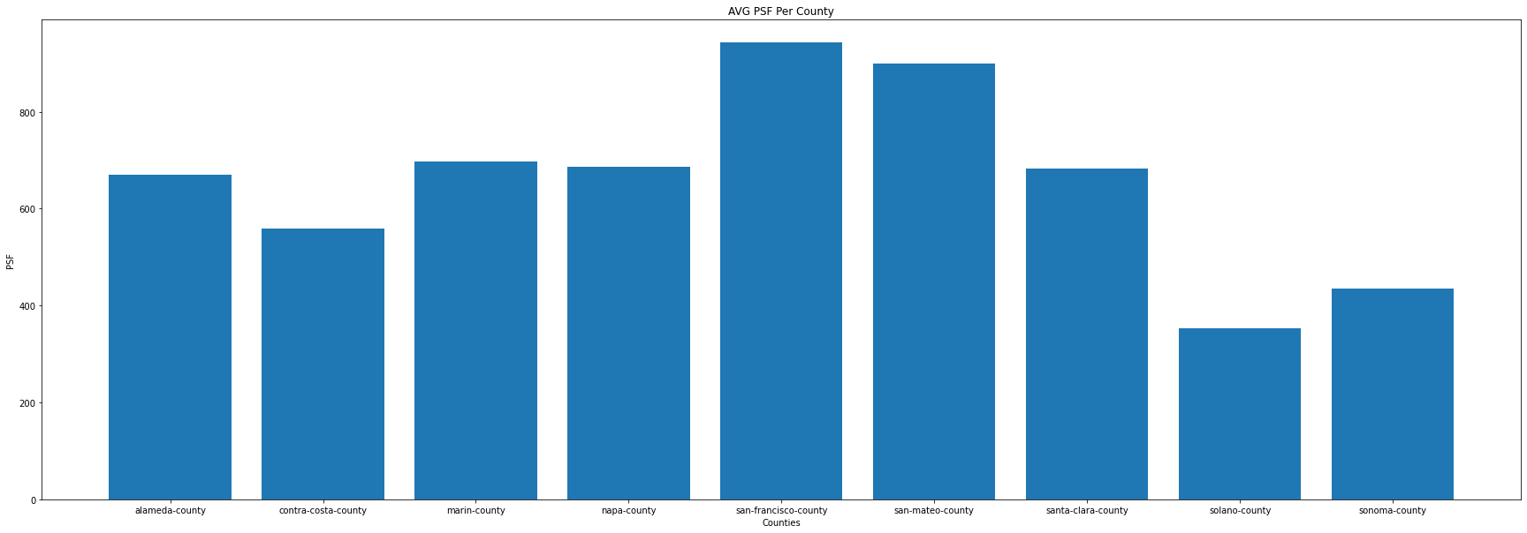
Avg PSF Grouped by County

Slide 6
Findings:
Most Expensive County PSF:
San Francisco County
Least Expensive County PSF:
Solano County

Slide 7
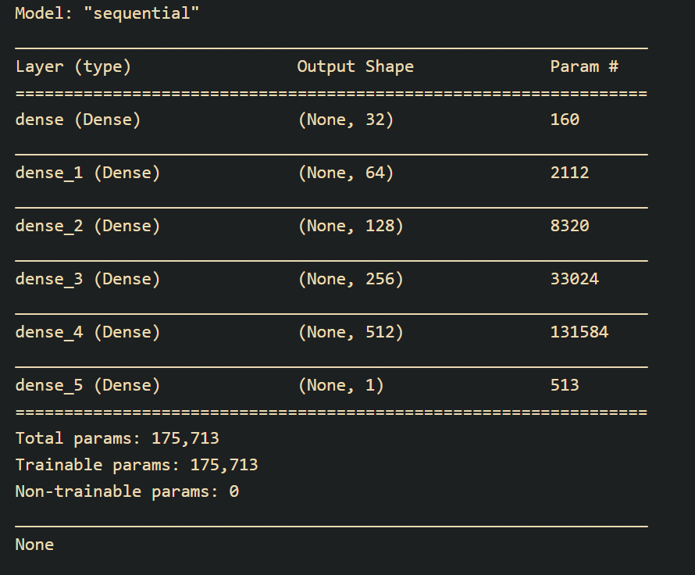
Neural Network Model
I built the model with 6 dense layers
I used these as my input variables:
Bed, Baths, Half Baths, and Sq Ft
Normalize the input
The output activation is ‘relu’ as my prediction is for pricing
Loss model is mse, metrics is mae, and optimizer is rmsprop
Ran 5 epochs with 15% validation split

Slide 8
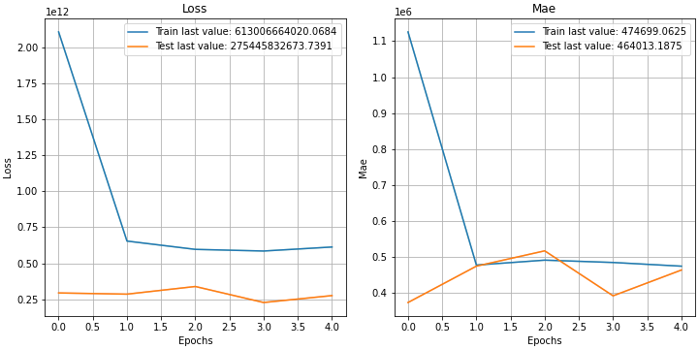
Neural Network Results:
The loss curve is dropping and flattening out. This is a good sign because the model is learning.
There is a tiny generalization error in the loss model. Good thing is that they don’t increase further than 3 epoch.
The MAE for our training is $474,699 and valid is $464,013. This means our error is off by this amount.
Overall, I think this is a good prediction because within $500,000 seems reasonable if you want to buy over million house(s) in the bay area.

